Slide 1
I210 – Introduction to Programming with Python
Lecture 16

Slide 2
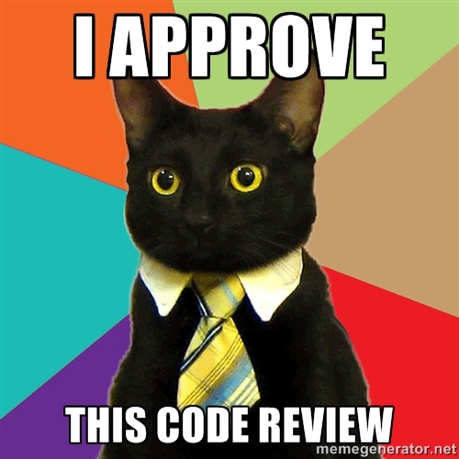
Today
Review for Lab Practical 2

Slide 3
Lab Practical
Coding problem
Open book, slides, notes, Oncourse, IDLE
But: No help from the internet or other people
Sharing your lab practical code, or using someone else's code, is not allowed. Remember academic integrity!
You may use your own laptop or a lab PC
Covers CH 1 – CH 6
All lab period to complete it

Slide 4
Recommendations
Get there early – use the time to open IDLE and log into Oncourse
Bookmark places in the book that you use a lot
Organize the sample code we’ve seen so far
Don’t try to solve everything at once – work on 1 part at a time

Slide 5
Topics we've seen since last practical:
String Methods
Formatting Output
File opening, reading, writing
For & While Loops
Nested Sequences
Dictionaries

Slide 6
Tuples vs. Lists vs. Dictionaries
Tuples my_tuple = ()
Immutable (can't change)
Use when you won't be adding, removing, modifying elements
Index with integers 0, 1, …
Lists my_list = []
Mutable (can change)
Use when you want to add, remove, modify
Allows sort, reverse, etc.
Index with integers 0, 1, …
Dictionaries my_dictionary = {}
Stores (key, value) pairs, where each key is distinct.
Dictionary allows easy indexing (looking up) based on key
Keys are usually strings
You can’t control the order of the keys in the dictionary

Slide 7
Which is better and easier?
Say we want to store exam grades, then look up the grades:
grades = {"Alice" : 99, "Bob" : 70, \
"Charlie" : 95, "Denise" : 90}
name = raw_input("Enter name: ")
if name in grades:
print grades[name]
else:
print "No such student."
names = ["Alice", "Bob", \
"Charlie", "Denise"]
grades = [99, 70, 95, 90]
name = raw_input("Enter name: ")
found = False
for i in range(len(names))
if names[i] == name:
print grades[i]
found = True
if not found:
print "No such student."

Slide 8
Today’s Problems!
Today’s problems are ON the prelim slides
Work on them at your own pace
Get checked off for each one!
If your group finishes all 3 problems, you’re done!

Slide 9
Vowel Counter (Group Work)
This program has errors in it. When we run it, we should get:
>>>
The message has 13 vowels in it.
It also has 2 ys in it.
Fix it!
Starter file is debug.py on Canvas
def vowel_count(string)
count = 0
y_count = 0
for letter as string:
if letter in vowels:
count += 1
elif letter != "y":
y_count += 1
return count
#main
vowels = [a, e, i, o, u]
message = "This is a test message. This is only a test. Only!"
total, ys = vowelcount()
print("The message has", total, "vowels in it."
print("It also has", ys, "ys in it.")

Slide 10
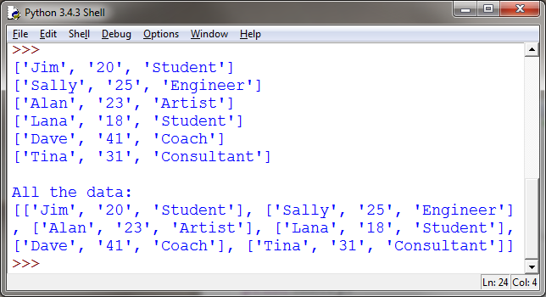
Data Read v1(Group Work)*
Produce this output:
Download professions.txt from Canvas
Jim, 20, Student
Sally, 25, Engineer
Alan, 23, Artist
Lana, 18, Student
Dave, 41, Coach
Tina, 31, Consultant
Hints:
.strip() gets rid of spaces and newlines at the beginning and end of a string
.split() allows you to break up a string into pieces

Slide 11

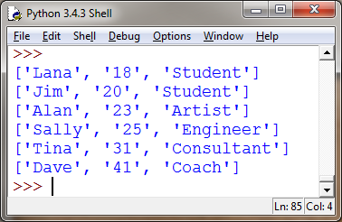
Data Read v2(Group Work)*
Produce this output,
which is sorted by age.
We recommend you implement Insertion Sort (from I201). You may look the algorithm up, but you will not get credit from just copying code!
You get 3 points just for trying this problem, if you stay until we explain it at the end of the class.
You get 2 Bonus points if you can solve the problem with code you wrote yourself!
This is challenging.
No points for solutions from the internet. If you can’t explain it, you didn’t write it.

Slide 12
Questions?

